Slide 1
Adaptive Dynamics

Slide 2
Justifications
We assume direct links between certain biological parameters
These links can be justified mechanistically
Or experimentally studied and justified
We consider evolution to occur through standard mutations, e.g. errors in replication of genes
We assume these mutations occur at a much slower timescale relative to the ecological or epidemiological dynamics we wish to study

Slide 3
Fitness
We can define fitness approximately as a measure of the average number of new individuals produced by a member of a specific class over the members entire lifespan
Then by assuming there is interclass competition, the species with the higher fitness will replace the lower fitness individuals
Through the adaptive dynamics assumptions just discussed, namely separation of timescales and links between parameters, we can begin to investigate questions

Slide 4
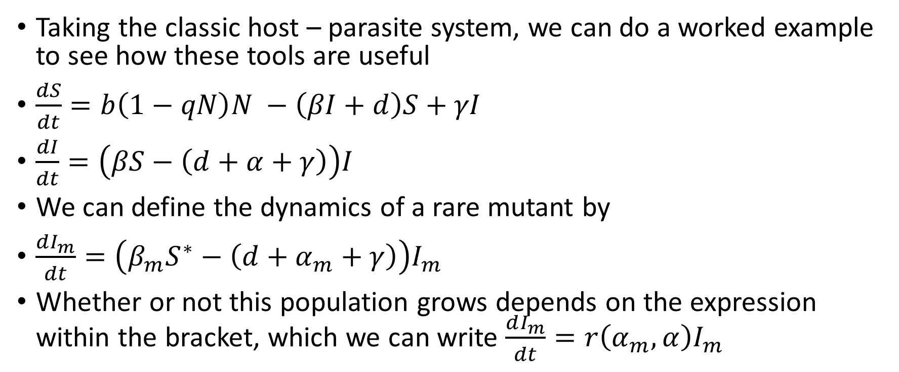
Toy Example
Taking the classic host – parasite system, we can do a worked example to see how these tools are useful
$\frac{dS}{dt}=b\left(1−qN\right)N −\left(βI+d\right)S+γI$
$\frac{dI}{dt}=\left(βS−\left(d+α+γ\right)\right)I$
We can define the dynamics of a rare mutant by
$\frac{dI_{m}}{dt}=\left(β_{m}S^{∗}−\left(d+α_{m}+γ\right)\right)I_{m}$
Whether or not this population grows depends on the expression within the bracket, which we can write $\frac{dI_{m}}{dt}=r\left(α_{m}, α\right)I_{m}$

Slide 5
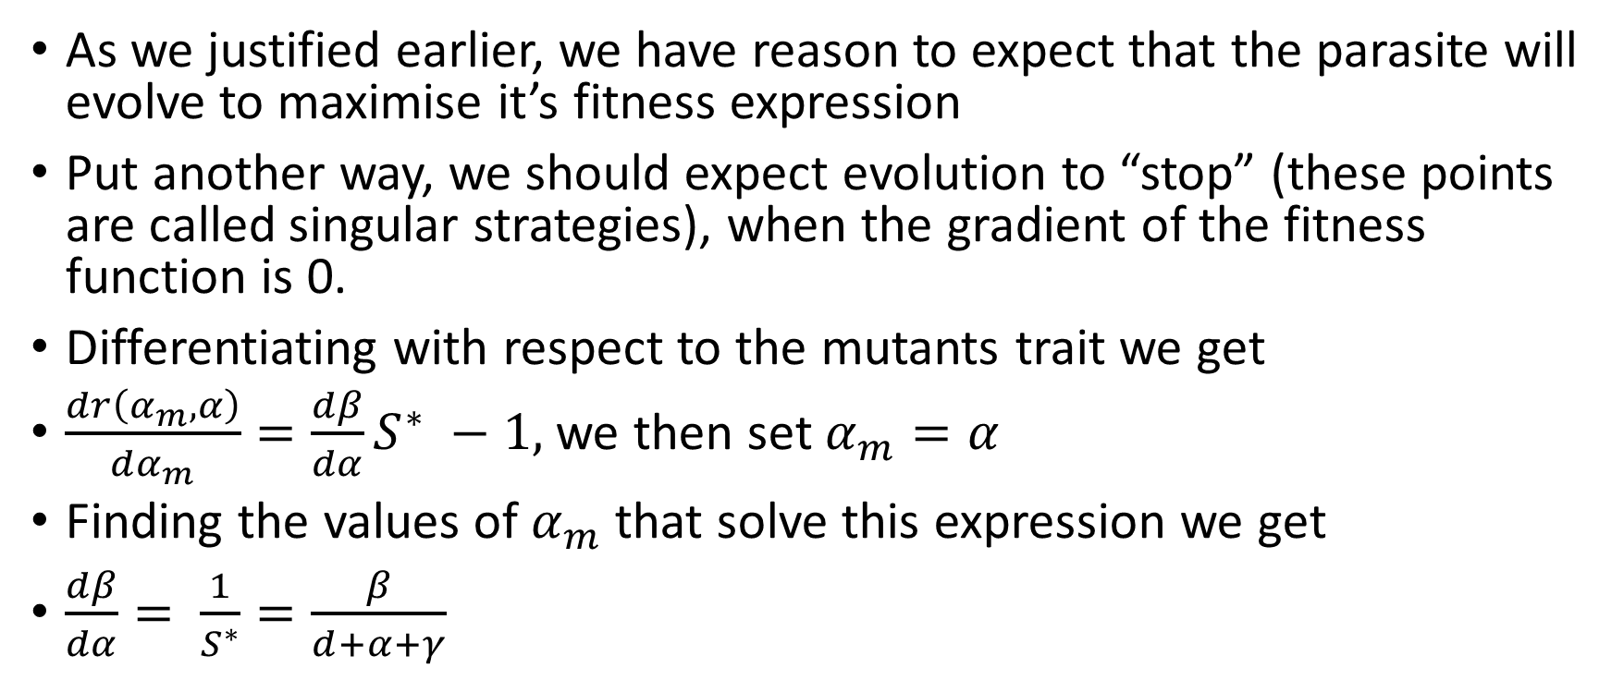
Toy Example
As we justified earlier, we have reason to expect that the parasite will evolve to maximise it’s fitness expression
Put another way, we should expect evolution to “stop” (these points are called singular strategies), when the gradient of the fitness function is 0.
Differentiating with respect to the mutants trait we get
$\frac{dr\left(α_{m}, α\right)}{dα_{m}}=\frac{dβ}{dα}S^{∗} −1,$ we then set $α_{m}=α$
Finding the values of $α_{m}$ that solve this expression we get
$\frac{dβ}{dα}= \frac{1}{S^{∗}}=\frac{β}{d+α+γ}$

Slide 6
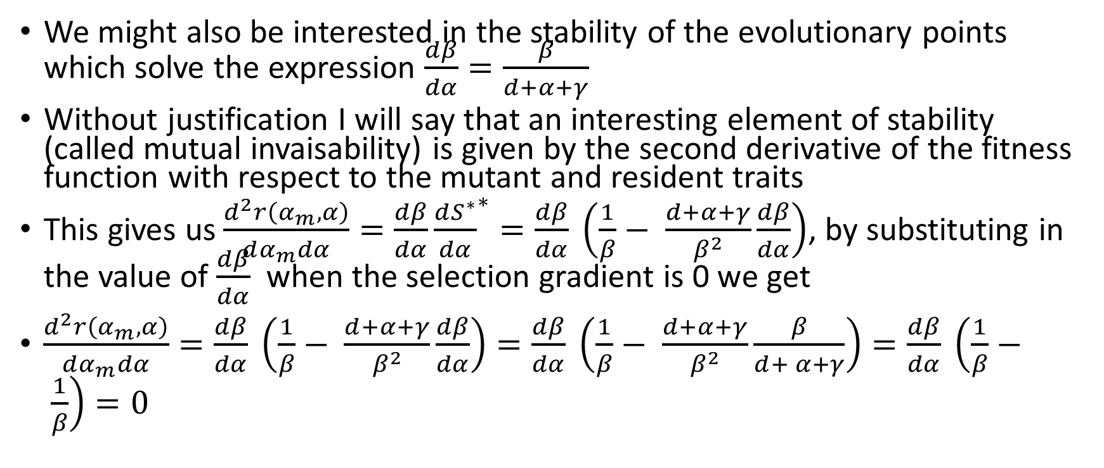
Toy Example
We might also be interested in the stability of the evolutionary points which solve the expression $\frac{dβ}{dα}=\frac{β}{d+α+γ}$
Without justification I will say that an interesting element of stability (called mutual invaisability) is given by the second derivative of the fitness function with respect to the mutant and resident traits
This gives us $\frac{d^{2}r\left(α_{m}, α\right)}{dα_{m}dα}=\frac{dβ}{dα}{\frac{dS^{∗}}{dα}}^{∗}=\frac{dβ}{dα} \left(\frac{1}{β}− \frac{d+α+γ}{β^{2}}\frac{dβ}{dα}\right)$, by substituting in the value of $\frac{dβ}{dα}$ when the selection gradient is 0 we get
$\frac{d^{2}r\left(α_{m}, α\right)}{dα_{m}dα}=\frac{dβ}{dα} \left(\frac{1}{β}− \frac{d+α+γ}{β^{2}}\frac{dβ}{dα}\right)=\frac{dβ}{dα} \left(\frac{1}{β}− \frac{d+α+γ}{β^{2}}\frac{β}{d+ α+γ}\right)=\frac{dβ}{dα} \left(\frac{1}{β}− \frac{1}{β}\right)=0$

Slide 7
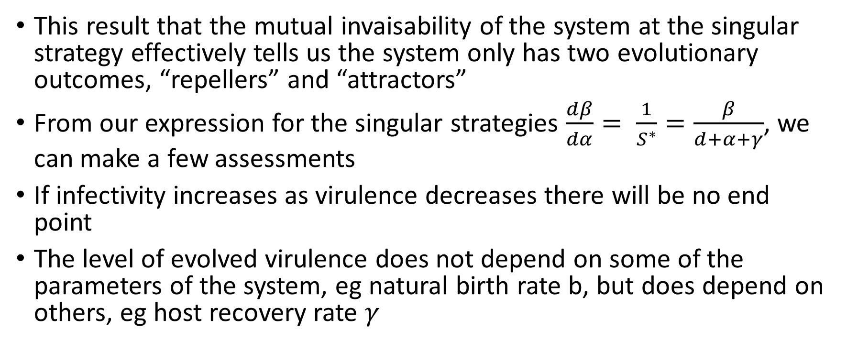
Toy Example
This result that the mutual invaisability of the system at the singular strategy effectively tells us the system only has two evolutionary outcomes, “repellers” and “attractors”
From our expression for the singular strategies $\frac{dβ}{dα}= \frac{1}{S^{∗}}=\frac{β}{d+α+γ}$, we can make a few assessments
If infectivity increases as virulence decreases there will be no end point
The level of evolved virulence does not depend on some of the parameters of the system, eg natural birth rate b, but does depend on others, eg host recovery rate $γ$

Slide 8
Toy Example

Slide 9
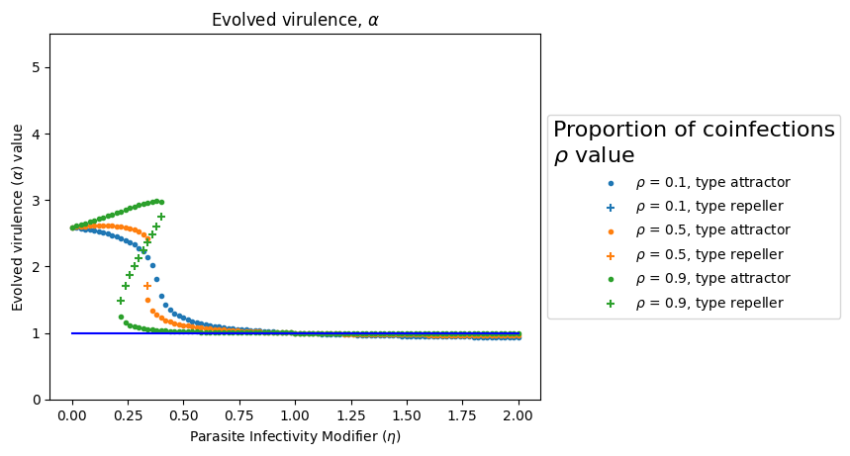
Evolutionary Consequences of Hyperparasite introduction

Slide 10
Why care about hyperparasites
There have been quite a large number of experimental studies investigating the evolutionary dynamics of parasites and hyperparasites in controlled media
However very little theoretical or experimental work has been done investigating these systems in more natural environments
Despite this hyperparasites are a hugely abundant class of species
Hyperparasites have also been used as forms of biocontrol, for example against chestnut blight fungus in the UK
Additionally hyperparasites such as bacteriophages represent a potential tool against emergent threats such as AMR diseases
However as parasites can adapt to hyperparasites in any of these settings, questions regarding how this affects the long term efficacy of these strategies must be answered

Slide 11
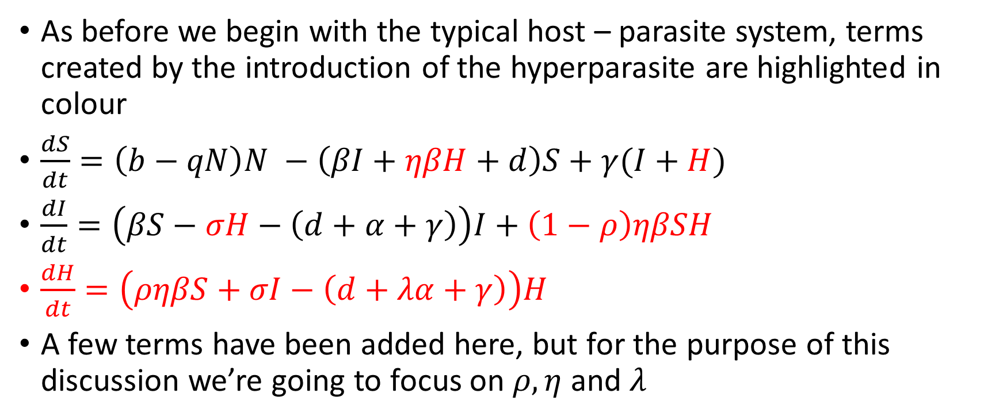
How do hyperparasites change the ecological dynamics
As before we begin with the typical host – parasite system, terms created by the introduction of the hyperparasite are highlighted in colour
$\frac{dS}{dt}=\left(b−qN\right)N −\left(βI+ηβH+d\right)S+γ(I+H)$
$\frac{dI}{dt}=\left(βS−σH−\left(d+α+γ\right)\right)I+\left(1−ρ\right)ηβSH$
$\frac{dH}{dt}=\left(ρηβS+σI−\left(d+λα+γ\right)\right)H$
A few terms have been added here, but for the purpose of this discussion we’re going to focus on $ρ, η$ and $λ$

Slide 12
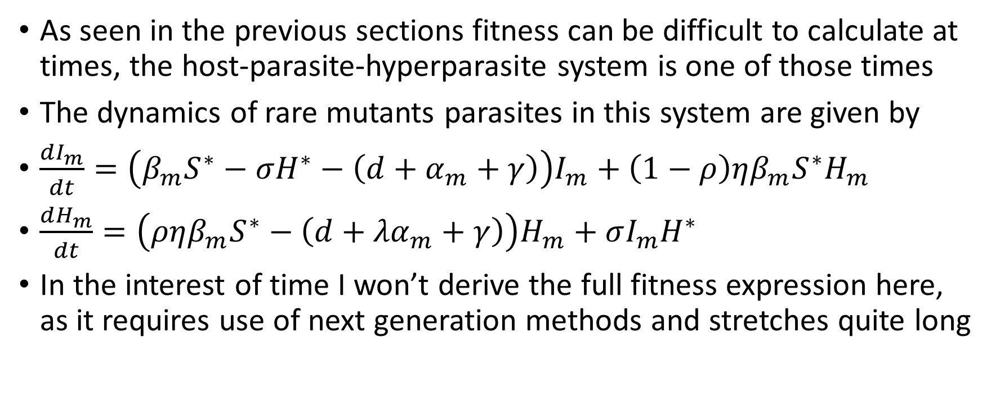
Hyperparasites and fitness
As seen in the previous sections fitness can be difficult to calculate at times, the host-parasite-hyperparasite system is one of those times
The dynamics of rare mutants parasites in this system are given by
$\frac{dI_{m}}{dt}=\left(β_{m}S^{∗}−σH^{∗}−\left(d+α_{m}+γ\right)\right)I_{m}+\left(1−ρ\right)ηβ_{m}S^{∗}H_{m}$
$\frac{dH_{m}}{dt}=\left(ρηβ_{m}S^{∗}−\left(d+{λα}_{m}+γ\right)\right)H_{m}+σI_{m}H^{∗}$
In the interest of time I won’t derive the full fitness expression here, as it requires use of next generation methods and stretches quite long

Slide 13

Hyperparasite fitness
The key points are
Hyperparasites represent a different path for infections
Hyperparasites can be a burden or advantageous (e.g. $λ<1$ and $η=1$)
Every infection by a hyperparasitised individual results in a new parasite, but not every infection results in a new hyperparasite

Slide 14
Changes to Singular strategy location
The introduction of Hyperparasites affects the fitness of the parasite, as a result they change the position of the singular strategy
Here we see a hysteresis affect, where the introduction of hyperparasites allows two singular strategies to exist at the same time

Slide 15
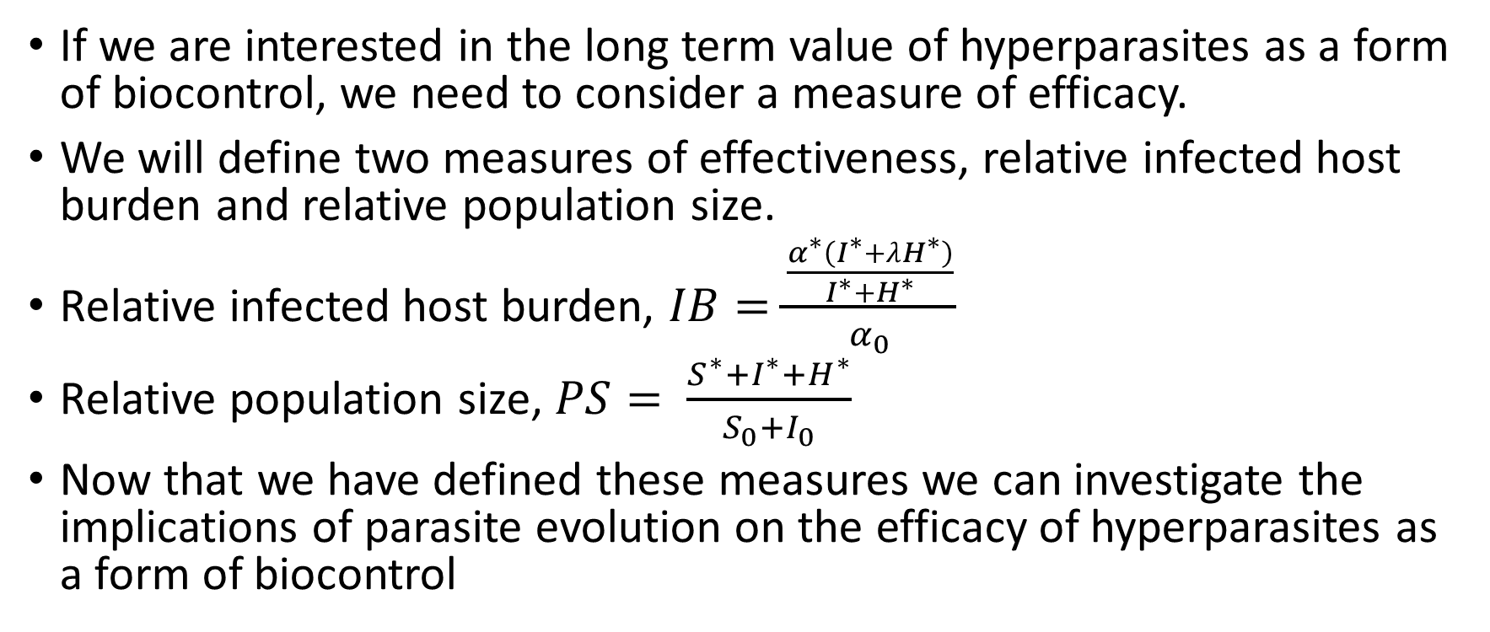
Implications for Biocontrol
If we are interested in the long term value of hyperparasites as a form of biocontrol, we need to consider a measure of efficacy.
We will define two measures of effectiveness, relative infected host burden and relative population size.
Relative infected host burden, $IB=\frac{\frac{α^{∗}\left(I^{∗}+λH^{∗}\right)}{I^{∗}+H^{∗}}}{α_{0}}$
Relative population size, $PS= \frac{S^{∗}+I^{∗}+H^{∗}}{S_{0}+I_{0}}$
Now that we have defined these measures we can investigate the implications of parasite evolution on the efficacy of hyperparasites as a form of biocontrol

Slide 16
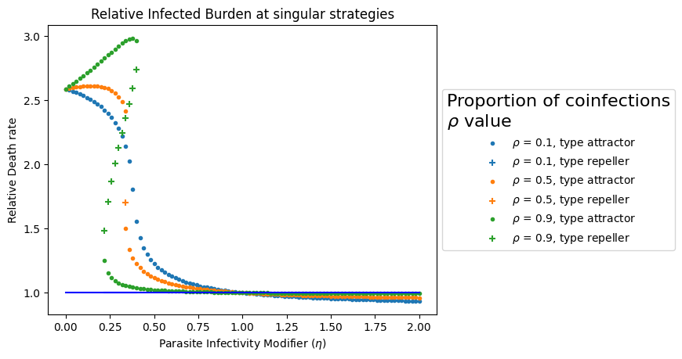
Affected on Infected Host Burden

Slide 17
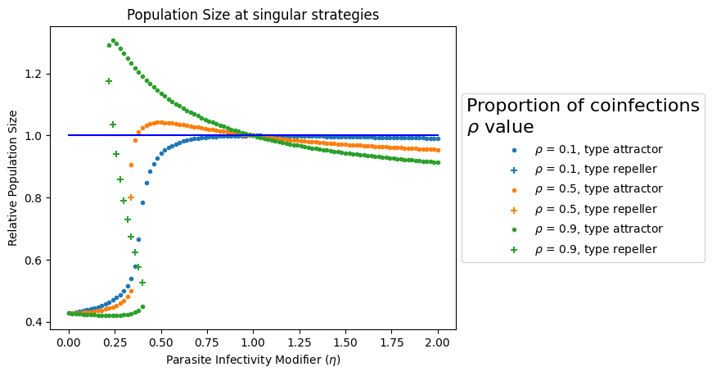
Affect on Population Size

Slide 18
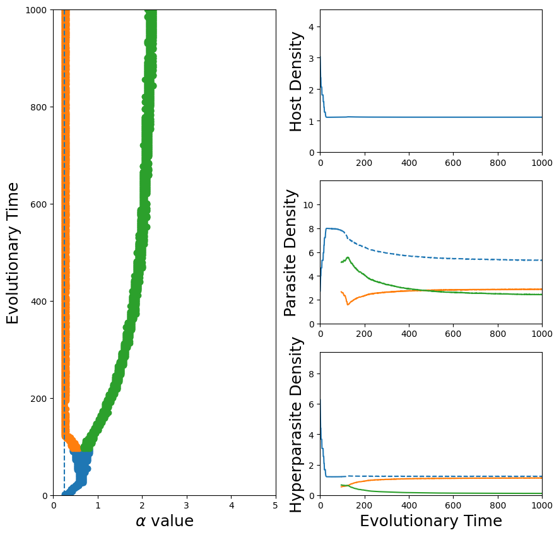
Diversification
The introduction of hyperparasites creates additional selection pressures making it possible (though not necessarily likely) for the parasite to evolve to a singular strategy and then split into two distinct strains

Slide 19
Conclusion

